Slide 1


Methods

Slide 2
Announcements

Slide 3
Civilization advances by extending the number of operations we can perform without thinking about them.
-Alfred North Whitehead

Slide 4
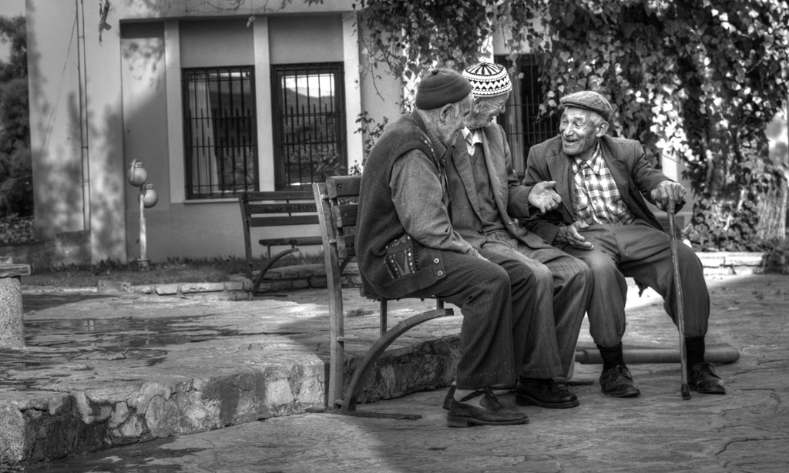

Slide 5
Calling Methods
turnRight();
move();
readInt(“Int please! ”);
println(“hello world”);
rect.getX();
drawRobotFace();
rect.setLocation(10, 20);
preventGlobalWarming();

Slide 6

Defining a Method
private void turnRight() {
turnLeft();
turnLeft();
turnLeft();
}

Slide 7
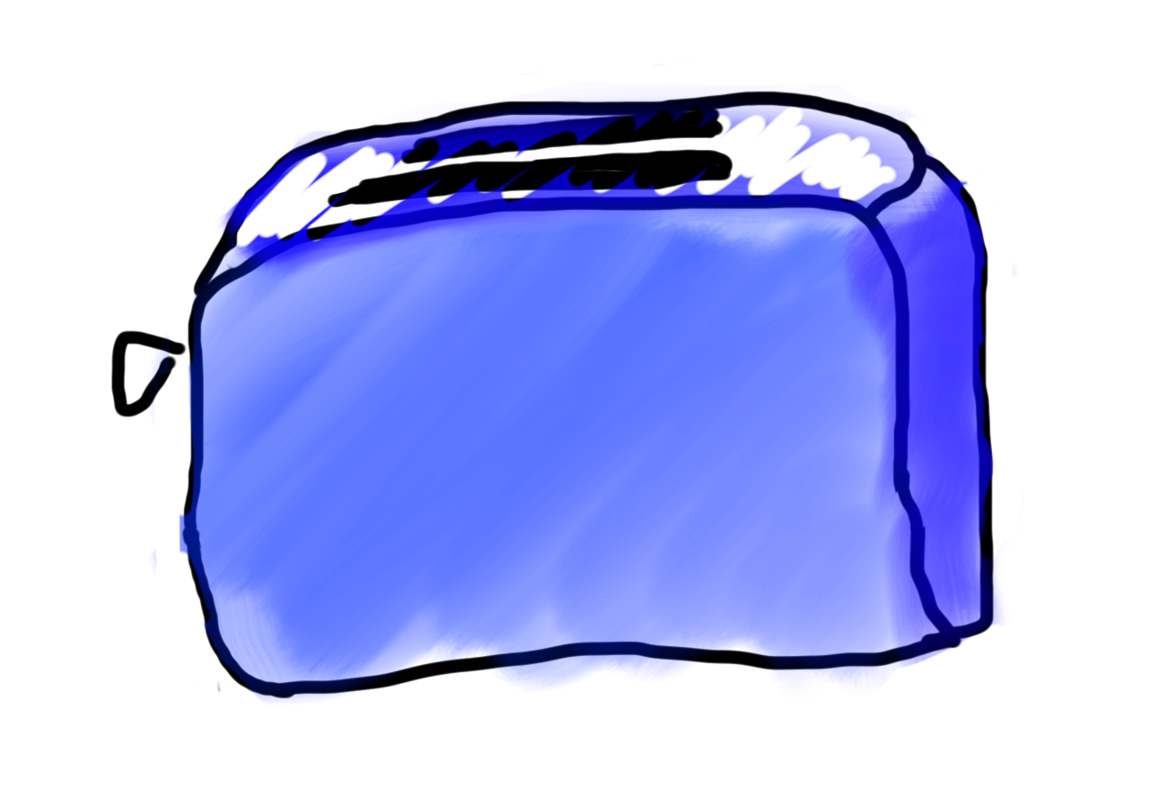
Methods are Like Toasters

Slide 8
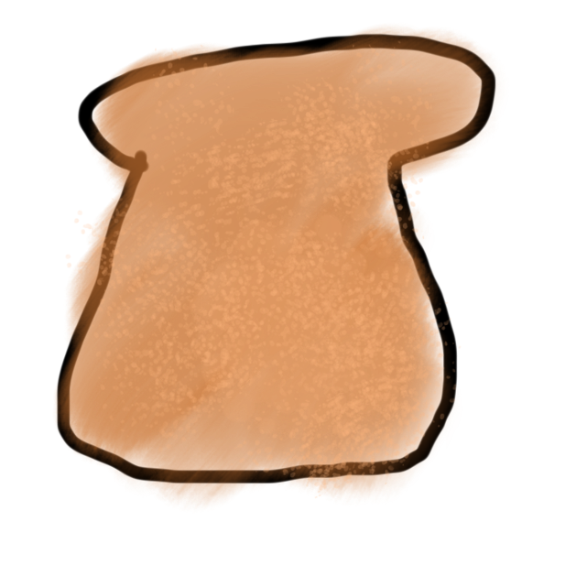
Methods are Like Toasters
parameter

Slide 9
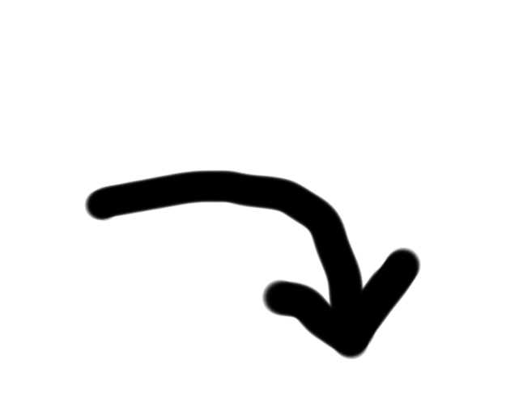
Methods are Like Toasters
parameter

Slide 10
Methods are Like Toasters

Slide 11

Methods are Like Toasters

Slide 12
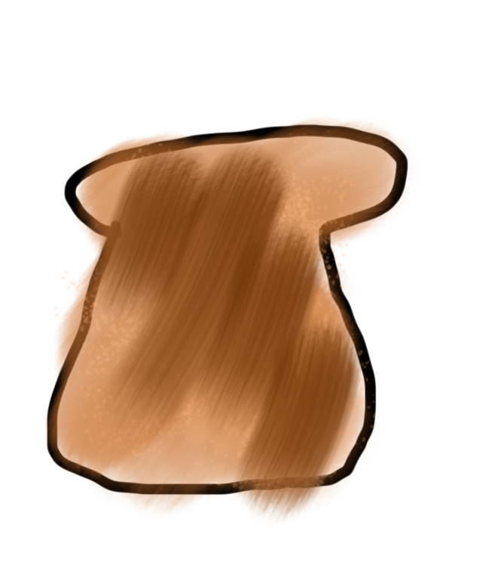
Methods are Like Toasters
return

Slide 13
Methods are Like Toasters

Slide 14
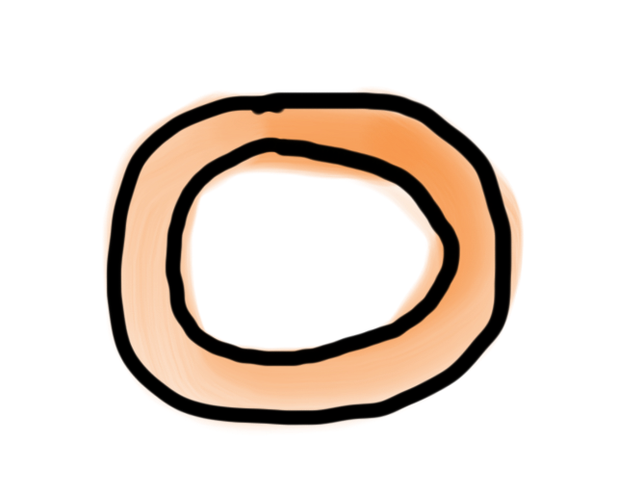
Methods are Like Toasters

Slide 15
Methods are Like Toasters

Slide 16
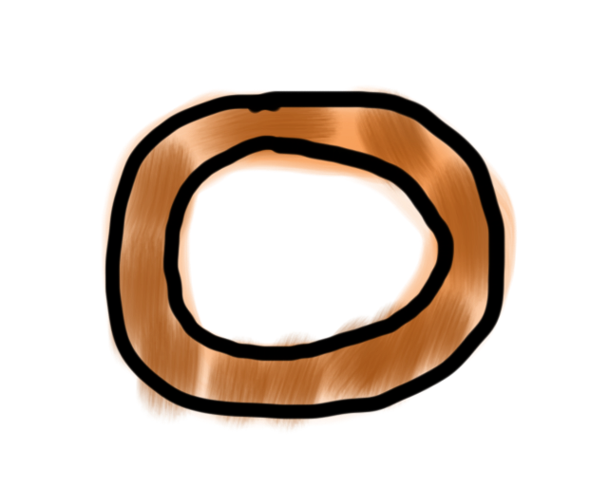
Methods are Like Toasters

Slide 17
Methods are Like Toasters

Slide 18
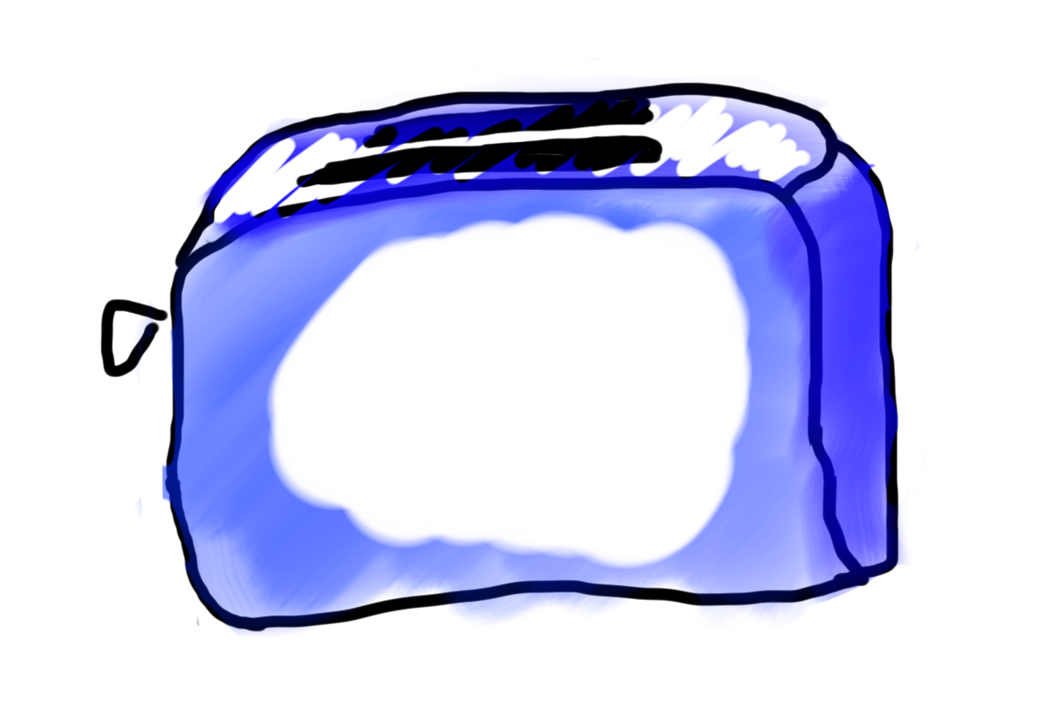
Methods are Like Toasters

Slide 19
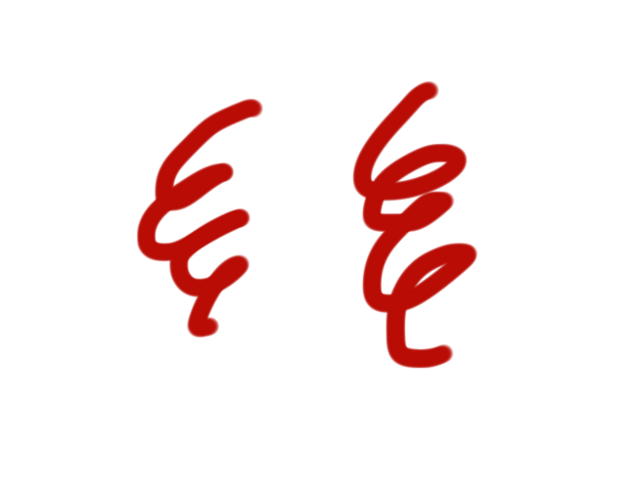
Methods are Like Toasters

Slide 20
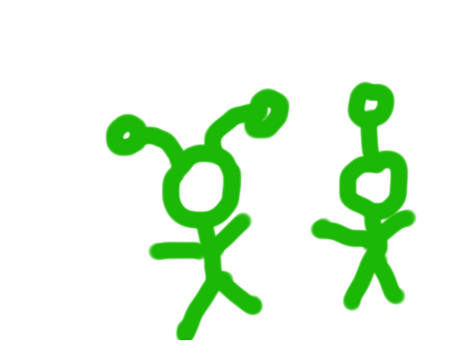
Methods are Like Toasters

Slide 21
Methods are Like Toasters
parameter(s)
return

Slide 22
Anatomy of a method
public void run() {
double mid = average(5.0, 10.2);
println(mid);
}
private double average(double a, double b) {
double sum = a + b;
return sum / 2;
}

Slide 23
Anatomy of a method
public void run() {
double mid = average(5.0, 10.2);
println(mid);
}
private double average(double a, double b) {
double sum = a + b;
return sum / 2;
}
Output expected
Input expected

Slide 24
Anatomy of a method
public void run() {
double mid = average(5.0, 10.2);
println(mid);
}
private double average(double a, double b) {
double sum = a + b;
return sum / 2;
}
name

Slide 25
Anatomy of a method
public void run() {
double mid = average(5.0, 10.2);
println(mid);
}
private double average(double a, double b) {
double sum = a + b;
return sum / 2;
}
body

Slide 26
Anatomy of a method
public void run() {
double mid = average(5.0, 10.2);
println(mid);
}
private double average(double a, double b) {
double sum = a + b;
return sum / 2;
}
return

Slide 27
Anatomy of a method
public void run() {
double mid = average(5.0, 10.2);
println(mid);
}
private double average(double a, double b) {
double sum = a + b;
return sum / 2;
}
method “call”

Slide 28

Learn by Example

Slide 29
Void Example
private void printIntro() {
println("Welcome to class");
println("It's the best part of my day.");
}
public void run() {
printIntro();
}

Slide 30
Example
private double metersToCm(double meters) {
return 100 * meters;
}
public void run() {
println(metersToCm(5.2));
}

Slide 31
Parameter Example
private void printOpinion(int num) {
if(num == 5) {
println(“I love 5!”);
} else {
println(“Whattever”);
}
}
public void run() {
printOpinion(5);
}

Slide 32
Multiple Return
private String getMonthName(int i) {
if (i == 0) {
return “January”;
}
if (i == 1) {
return “February”;
}
…
return “Unknown”;
}

Slide 33
Defining a Method
visibility type nameOfMethod(parameters) {
statements
}
visibility: usually private or public
type: type returned by method (e.g., int , double, etc.)
Can be void to indicate that nothing is returned
parameters: information passed into method

Slide 34
private void run() {
double r = readPositive(“Enter radius: “);
double area = getArea(r);
println(area);
}
private double readPositive(String prompt) {
double value = readDouble(prompt);
while(value < 0) {
println(“Invalid”);
value = readDouble(prompt);
}
return value;
}
private double getArea(double radius) {
return PI * radius * radius;
}

Slide 35
private void run() {
double r = readPositive(“Enter radius: “);
double area = getArea(r);
println(area);
}

Slide 36
private void run() {
double r = readPositive(“Enter radius: “);
double area = getArea(r);
println(area);
}

Slide 37
private void run() {
double r = readPositive(“Enter radius: “);
double area = getArea(r);
println(area);
}

Slide 38
private void run() {
double r = readPositive(“Enter radius: “);
double area = getArea(r);
println(area);
}
private double readPositive(String prompt) {
double value = readDouble(prompt);
while(value < 0) {
println(“Invalid”);
value = readDouble(prompt);
}
return value;
}

Slide 39
private void run() {
double r = readPositive(“Enter radius: “);
double area = getArea(r);
println(area);
}
private double readPositive(String prompt) {
double value = readDouble(prompt);
while(value < 0) {
println(“Invalid”);
value = readDouble(prompt);
}
return value;
}
prompt
“Enter radius: “

Slide 40
private void run() {
double r = readPositive(“Enter radius: “);
double area = getArea(r);
println(area);
}
private double readPositive(String prompt) {
double value = readDouble(prompt);
while(value < 0) {
println(“Invalid”);
value = readDouble(prompt);
}
return value;
}
prompt
“Enter radius: “
value
-3

Slide 41
private void run() {
double r = readPositive(“Enter radius: “);
double area = getArea(r);
println(area);
}
private double readPositive(String prompt) {
double value = readDouble(prompt);
while(value < 0) {
println(“Invalid”);
value = readDouble(prompt);
}
return value;
}
prompt
“Enter radius: “
value
-3

Slide 42
private void run() {
double r = readPositive(“Enter radius: “);
double area = getArea(r);
println(area);
}
private double readPositive(String prompt) {
double value = readDouble(prompt);
while(value < 0) {
println(“Invalid”);
value = readDouble(prompt);
}
return value;
}
prompt
“Enter radius: “
value
-3

Slide 43
private void run() {
double r = readPositive(“Enter radius: “);
double area = getArea(r);
println(area);
}
private double readPositive(String prompt) {
double value = readDouble(prompt);
while(value < 0) {
println(“Invalid”);
value = readDouble(prompt);
}
return value;
}
prompt
“Enter radius: “
value
-3

Slide 44
private void run() {
double r = readPositive(“Enter radius: “);
double area = getArea(r);
println(area);
}
private double readPositive(String prompt) {
double value = readDouble(prompt);
while(value < 0) {
println(“Invalid”);
value = readDouble(prompt);
}
return value;
}
prompt
“Enter radius: “
value
42

Slide 45
private void run() {
double r = readPositive(“Enter radius: “);
double area = getArea(r);
println(area);
}
private double readPositive(String prompt) {
double value = readDouble(prompt);
while(value < 0) {
println(“Invalid”);
value = readDouble(prompt);
}
return value;
}
prompt
“Enter radius: “
value
42

Slide 46
private void run() {
double r = readPositive(“Enter radius: “);
double area = getArea(r);
println(area);
}
private double readPositive(String prompt) {
double value = readDouble(prompt);
while(value < 0) {
println(“Invalid”);
value = readDouble(prompt);
}
return value;
}
prompt
“Enter radius: “
value
42

Slide 47
private void run() {
double r = readPositive(“Enter radius: “);
double area = getArea(r);
println(area);
}
private double readPositive(String prompt) {
double value = readDouble(prompt);
while(value < 0) {
println(“Invalid”);
value = readDouble(prompt);
}
return value;
}
prompt
“Enter radius: “
value
42

Slide 48
private void run() {
double r = readPositive(“Enter radius: “);
double area = getArea(r);
println(area);
}
42

Slide 49
private void run() {
double r = readPositive(“Enter radius: “);
double area = getArea(r);
println(area);
}
42
r
42

Slide 50
private void run() {
double r = readPositive(“Enter radius: “);
double area = getArea(r);
println(area);
}
r
42

Slide 51
private void run() {
double r = readPositive(“Enter radius: “);
double area = getArea(r);
println(area);
}
r
42

Slide 52
private void run() {
double r = readPositive(“Enter radius: “);
double area = getArea(r);
println(area);
}
private double getArea(double radius) {
return PI * radius * radius;
}
r
42

Slide 53
private void run() {
double r = readPositive(“Enter radius: “);
double area = getArea(r);
println(area);
}
private double getArea(double radius) {
return PI * radius * radius;
}
r
radius
42
42

Slide 54
private void run() {
double r = readPositive(“Enter radius: “);
double area = getArea(r);
println(area);
}
private double getArea(double radius) {
return PI * radius * radius;
}
r
radius
42
42

Slide 55
private void run() {
double r = readPositive(“Enter radius: “);
double area = getArea(r);
println(area);
}
private double getArea(double radius) {
return PI * radius * radius;
}
5538.96
r
radius
42
42

Slide 56
private void run() {
double r = readPositive(“Enter radius: “);
double area = getArea(r);
println(area);
}
5538.96
r
42

Slide 57
private void run() {
double r = readPositive(“Enter radius: “);
double area = getArea(r);
println(area);
}
5538.96
r
42

Slide 58
private void run() {
double r = readPositive(“Enter radius: “);
double area = getArea(r);
println(area);
}
5538.96
r
42
area
5538.96

Slide 59
private void run() {
double r = readPositive(“Enter radius: “);
double area = getArea(r);
println(area);
}
r
42
area
5538.96

Slide 60
private void run() {
double r = readPositive(“Enter radius: “);
double area = getArea(r);
println(area);
}
r
42
area
5538.96

Slide 61
Bad Times With Methods
// NOTE: This program is buggy!!
private void addFive(int x) {
x += 5;
}
public void run() {
int x = 3;
addFive(x);
println("x = " + x);
}

Slide 62
Good Times With Methods
// NOTE: This program is feeling just fine...
private int addFive(int x) {
x += 5;
return x;
}
public void run() {
int x = 3;
x = addFive(x);
println("x = " + x);
}

Slide 63
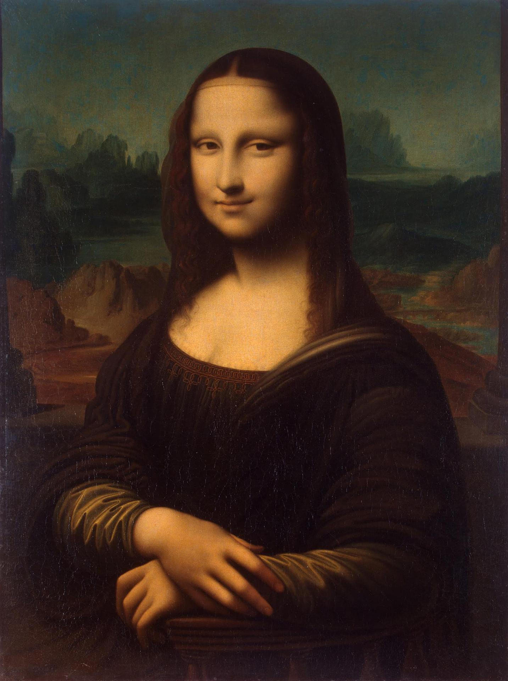
Pass by “Value”

Slide 64
More Examples

Slide 65
Changed Name
private void run() {
int num = 5;
cow(num);
}
private void cow(int grass) {
println(grass);
}

Slide 66
Same Variable
private void run() {
int num = 5;
cow();
}
private void cow() {
int num = 10;
println(num);
}

Slide 68
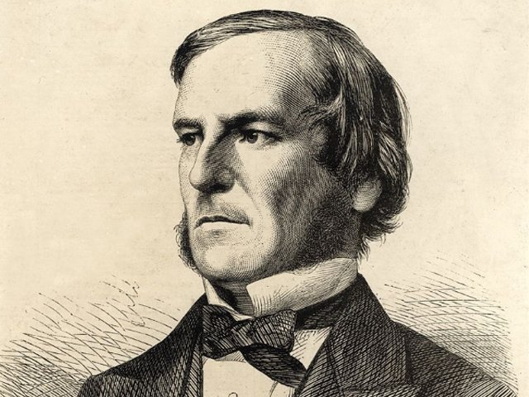
Booleans

Slide 69

Boolean

Slide 70
Boolean Variable
boolean karelIsAwesome = true;
boolean myBool = 1 < 2;

Slide 71
Boolean Operations
boolean a = true;
boolean b = false;
boolean and = a && b;
boolean or = a || b;
boolean not = !a;

Slide 72


Slide 73
